Slide 1
ETConnect - MyQuorum Upgrade Training
External Shippers, Accountants and Operators
September 21, 2022

Slide 2
Agenda
Introductions
Training Format: Power Point Deck and Environment Demonstration
Upgrades to MY QUORUM WEB-BASED PLATFORM v17
MY QUORUM Log In Details
Web Look and Navigation
Functionality – Changes that affect you
Nomination Upload Option
Reports
Next Steps

Slide 3
ETConnect V17 Upgrade to MyQuorum Web
What is Changing?
Dashboard (Level 1, 2, and 3)
Nomination Submission Screen
Confirmation Response Screen
Reporting
Note:
Functionality remains the same, the only changes are the Web look and feel

Slide 4
ETConnect MyQuorum Upgrades
UPGRADES TO MY QUORUM WEB-BASED PLATFORM v17 INCLUDE:
My Quorum Log In and Access
Web Access from anywhere using Chrome or Edge
Header and Footer Bars
Breadcrumbs System to Dashboard
Persona Concept
Alerts
Screen Search & Action Menu

Slide 5
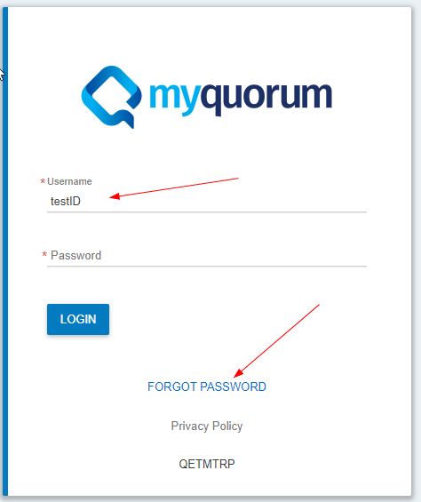
ETConnect MyQuorum Web – First time login
Use this hyperlink to get to the login page for the test environment
https://QuorumCommercialMO.energytransfer.com
New log in page, user will enter their user ID, and click on “Forgot Password”

Slide 6
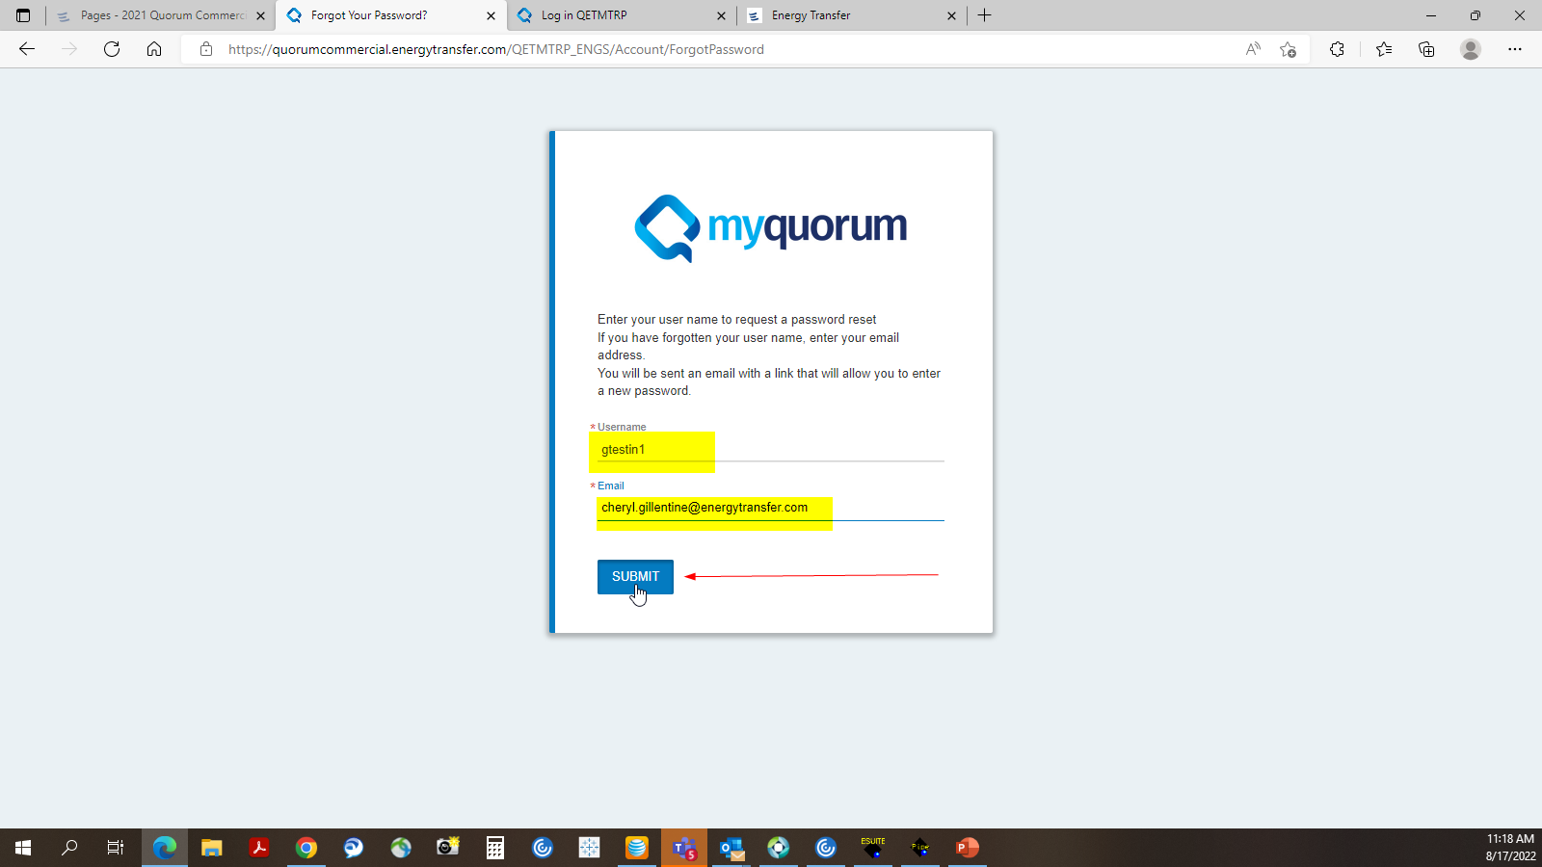
Resetting your Password
On this screen, enter your user ID and your email address. Click Submit.

Slide 7
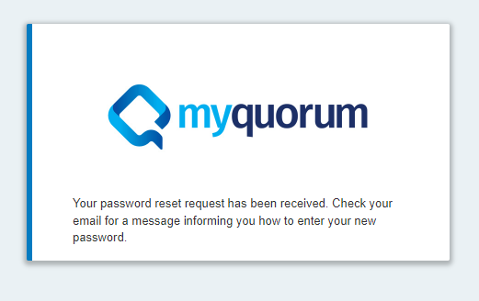
ETConnect MyQuorum Password Reset
You will see this message, then go to your inbox for an email with a reset link to create a new password.

Slide 8
Resetting your Password
You will receive an email within 5 mins similar to what you see below. Click on the “here” link to reset the password.

Slide 9
Resetting Password
Enter new password, confirm new password, click submit. You are now ready to login with the new password.
Password Requirements: At least 8 Characters, 1 Uppercase, 1 Lowercase, 1 Number, and 1 Special character (Ex. #, $, %, *)

Slide 10
MyQuorum Login Details
Preferred Browsers:
- Google Chrome
- Microsoft Edge
- Internet Explorer (limited MS Support) NOTE: This browser has known issues.
Web-based system log-in credentials, password protocols, and user roles will remain the same as they are today
Passwords will need to be updated every 90 days. You can reach the portal to change your password by clicking on the Forgot Password link on the Login screen
New Users will request access using current New User Request Form found by going to any of the pipeline EBB’s, clicking on Forms and download the form

Slide 11
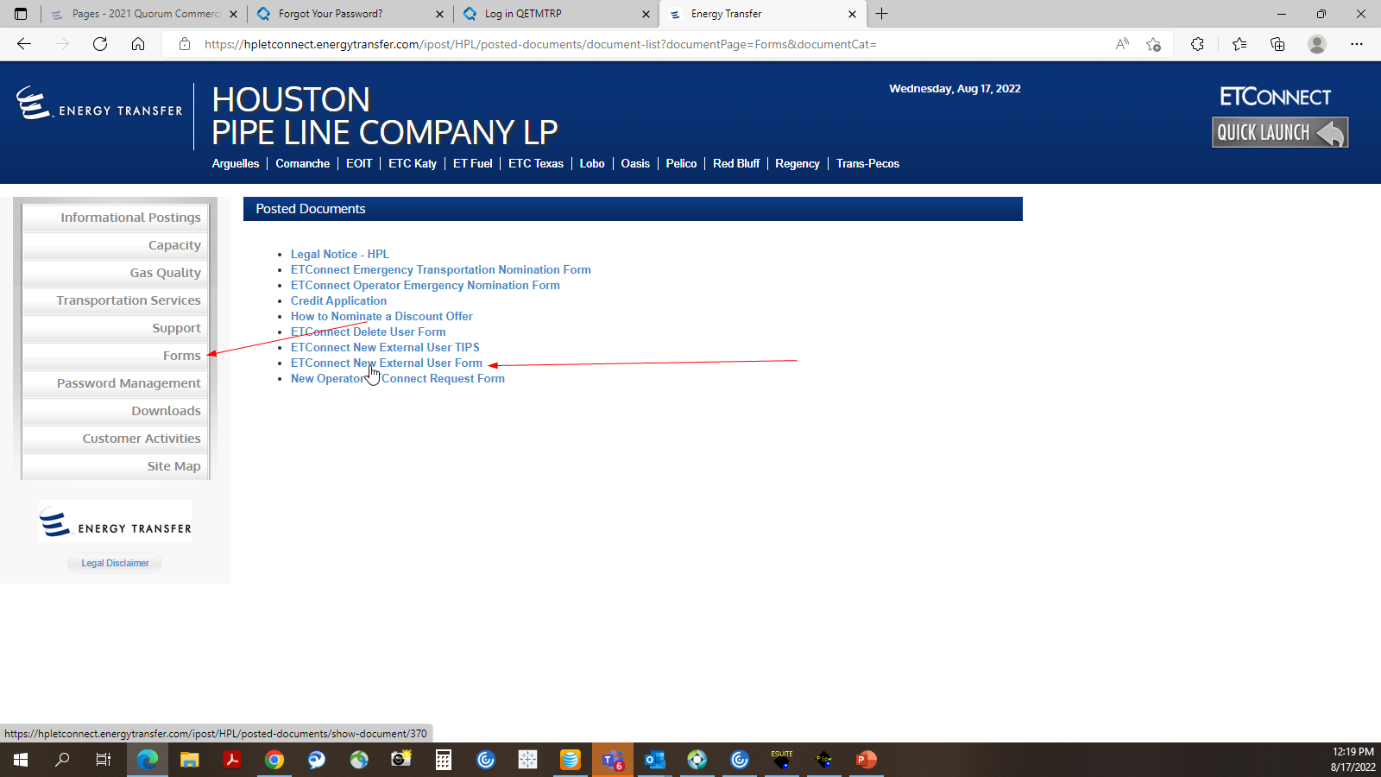
ETConnect New User Request Form
New Users will request access using the current New User Request Form found by going to any of the pipeline EBB’s, clicking on Forms and download the form

Slide 12
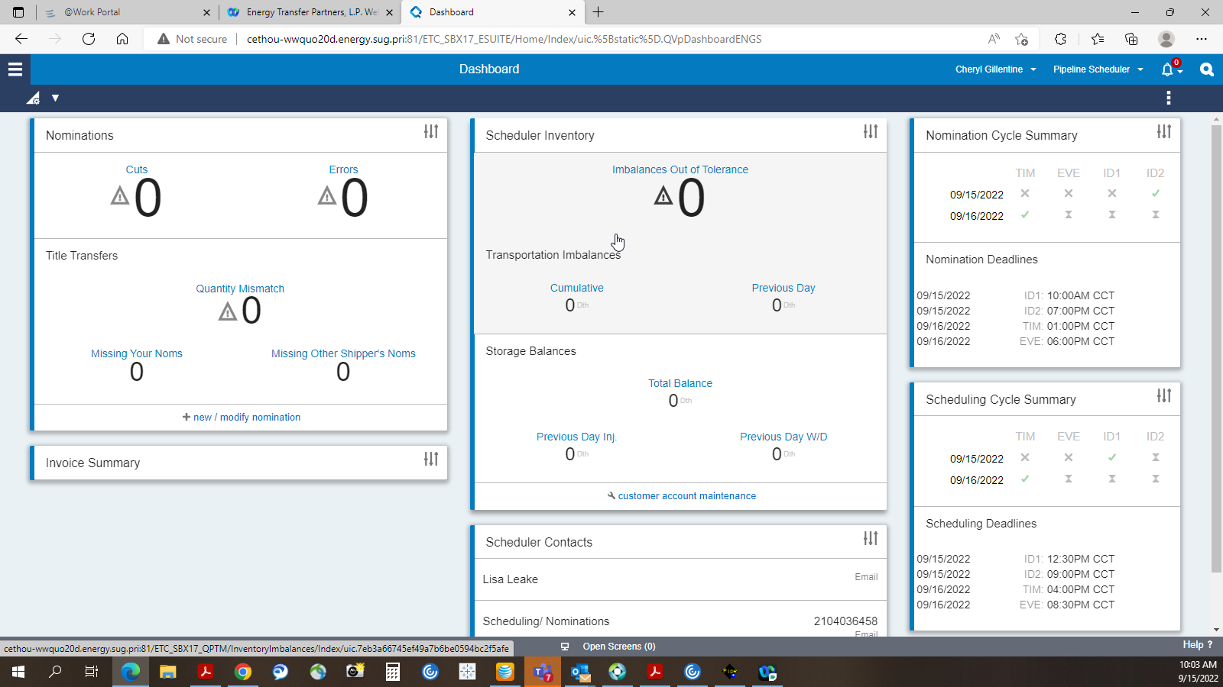
Dashboard View

Slide 13
Web Demo - Screen Shots (Header and Footers….)
User Menu - Displays your username. Select the User Menu to access My Profile, Open Screen Menu, and the Sign Out option.
Persona Menu - Displays your current Persona, which is the current role you are using to access the application. Select the Persona Menu to view all the available personas. You can use this menu to switch between your personas if you have more than one
Alerts - Displays the number of recent alerts. All recent alerts, including errors, warnings, and information will be stored in the Alert Center until dismissed
Screen Search - Click the Search Icon to prompt the Search bar. The search results will narrow as you type, and you can choose from the results list to navigate to a specific screen
Note: The screen list will list the module that the screen is for and if a screen is already open (active)

Slide 14
Web Demo - Screen Shots (Header and Footers cont…)
Overflow Menu - Displays additional actions that can be taken from the screen. Things such as less frequently used actions, editing your dashboard and links to related screens are often found in overflow menus
Context Data - Displays the selected context data for your application broken out by module
Hamburger Menu - Click the Hamburger menu icon to view the application menu and sitemap similar to the menu tree in the current ETConnect QPTM
Action Bar - Displays the available actions that can be taken on the screen

Slide 15
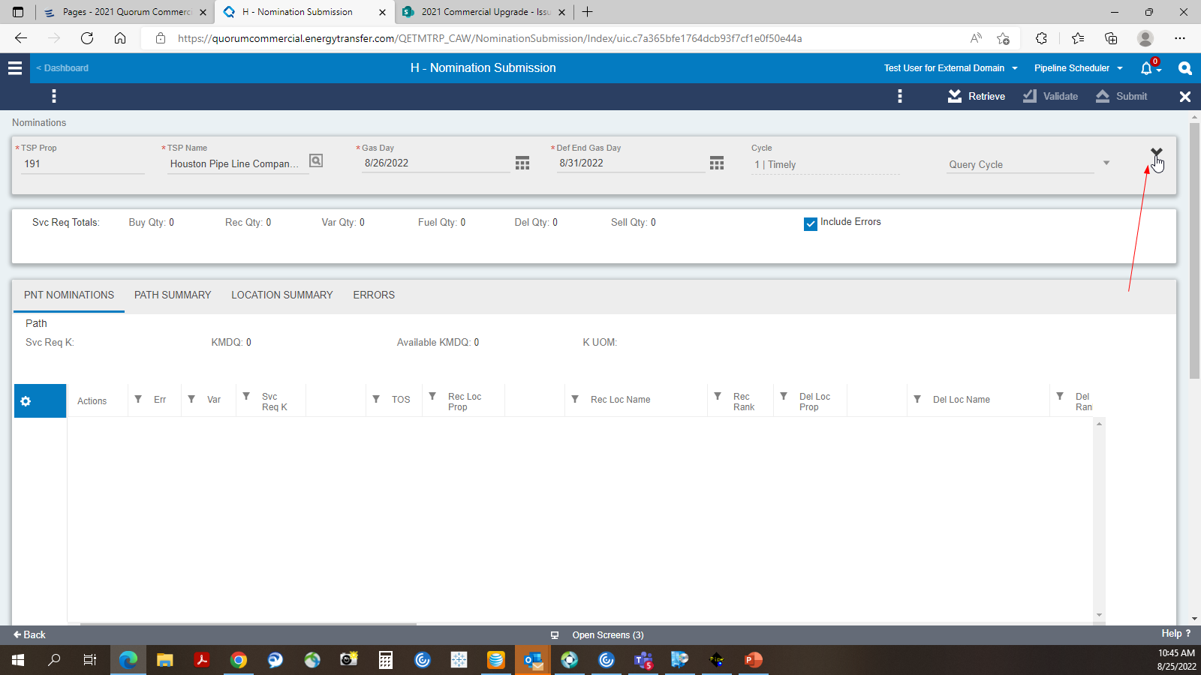
Web Demo - Nomination Submission
Click on the down arrow on the right to expand the header

Slide 16
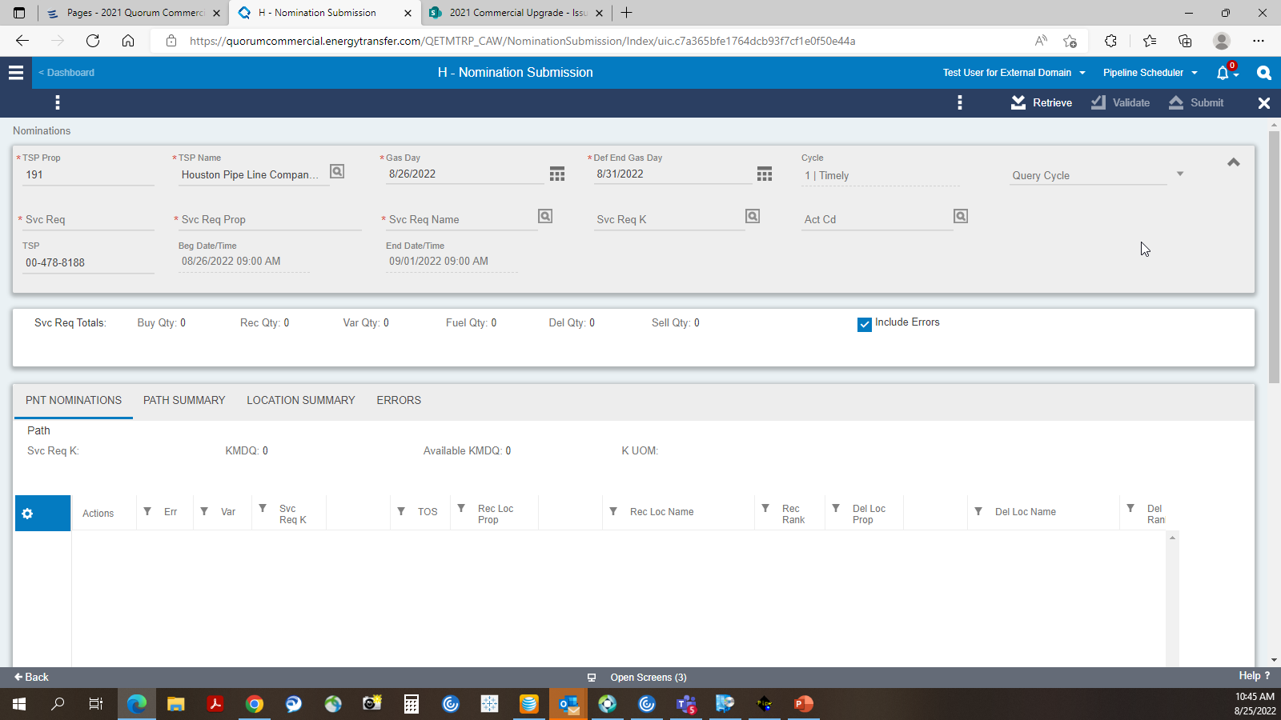
ETConnect MyQuorum – Nomination Screen

Slide 17
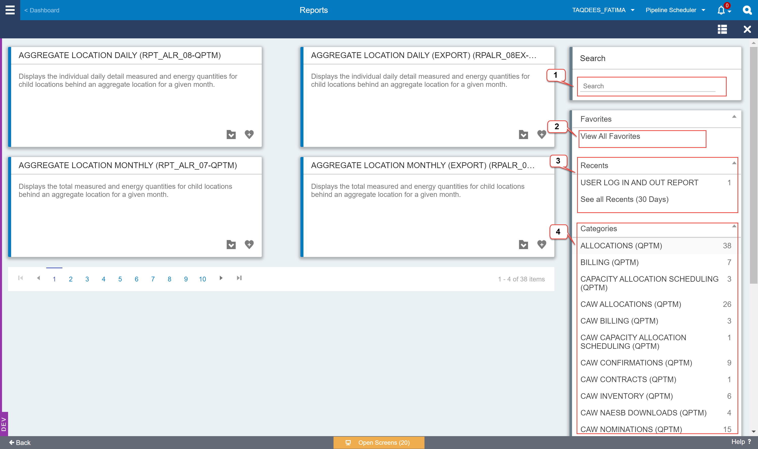
ETConnect MyQuorum Upgrade - Reports

Slide 18
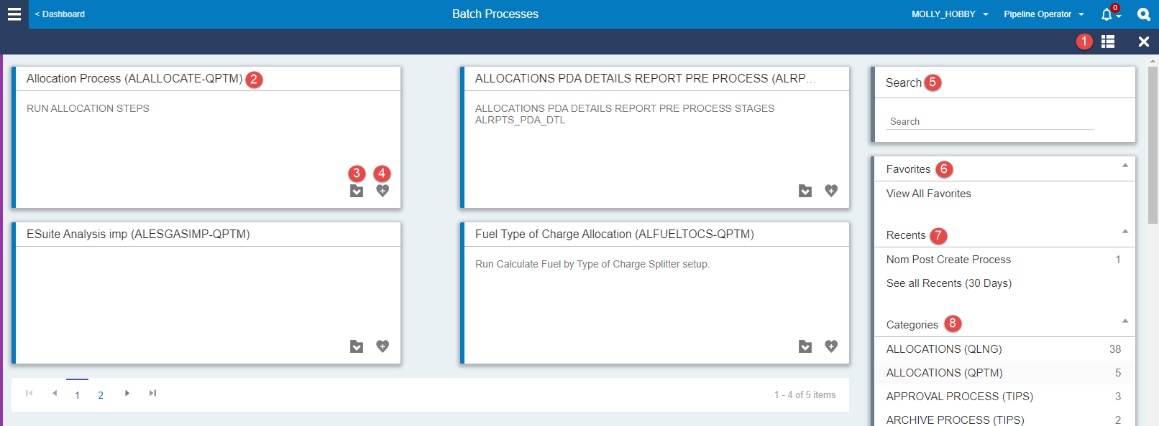
Reports (cont…)
Toggle View – Allows you move between the list or grid view. The Grid View displays a process title and description, while the list view is more compact and allows you to see more of the available processes and reports at once.
Batch Process/Report Container – Displays the process/report title, description and actions to launch a process or add it to your favorites.
Launch Process/Report – Launches the input parameter window and progress dialog

Slide 19
Reports (cont…)
Add Favorite – Allows you to select a process to add to your designated favorites list. Before saving a process as a favorite, it will prompt you to enter the default parameters for this process
Search – Similar to the Global Search Bar, this allows you to search for processes or reports by name.
Favorites – Menu section where the processes or reports that have been added as favorites are displayed.
Recents – Displays the processes that you have run in the past 30 days and the number of times the process was run.
Categories – Organizes the available processes into functional areas and displays the total number of reports in a given area

Slide 20
NEXT STEPS
Cutover Scheduled for October 7, 2022
Estimated Planned Down Time
- 10/7 10:00 pm through 10/8 8:00 am

Slide 21
ETConnect MyQuorum Upgrade – Contact Email
Please use the following e-mail for:
Questions related to web navigation
Login issues
General Application Questions
dlMyQuorumWeb@energytransfer.com

Slide 22
ETConnect MyQuorum Upgrade – Questions?

